Slide 1

Challenge 8: Provide Insights to the Product Strategy Team in the Banking Domain.
KATRAVATH RAJENDAR

Slide 2
Agenda:
Problem statement.
Objectives
Insights.
conclusion

Slide 3
Problem statement :
Problem statement :
Mitron Bank is a legacy financial institution headquartered in Hyderabad. They want to introduce a new line of credit cards, aiming to broaden its product offerings and reach in the financial market.
AtliQ Data Services came to know about this through an internal link and approached Mitron Bank with a proposal to implement this project. However, strategy director of Mitron Bank, Mr.Bashnir Rover is skeptical and asked them to do a pilot project with the sample data before handing them the full project. They provided a sample dataset of 4000 customers across five cities on their online spend and other details.
Peter Pandey is a data analyst at AtliQ Data Services and asked by his manager to take over this project. His role is to analyse the provided sample data and report key findings to the strategy team of Mitron Bank. This analysis is expected to guide them in tailoring the credit cards to customer needs and market trends.

Slide 4
objective:
Mitron Bank is a legacy financial institution headquartered in Hyderabad. They want to introduce a new line of credit cards, aiming to broaden its product offerings and reach in the financial market.

Slide 5
Insights:
Based on understanding the datasets,problem staement and tony insights I find some key insights through the occupation and city columns from the dataset.
Comparing between cities like Mumbai, Delhi, Bengaluru, Hyderabad and chennai. Mumabi is the top place in every sector of occupations like in IT, bussiness , freelance, govt jobs and others jobs.

Slide 6
City :Mumbai
Mumbai city total Avg_income is 56 Millions
Total money spend by Mumbai is 172 Millions
Total income utilization in percentage is 308.56
Total spend amound based on month by all occuaptions is:
month | spend
May | 22 Millions
June | 26 Millions
July | 26 Millions
Aug | 33 Millions
Sep | 38 Millions
Oct | 28 Millions

Slide 7
Total spend by the marital status in Mumabi city:
Marital status | spend
Married | 134 Millions
single | 38 Millions

Slide 8
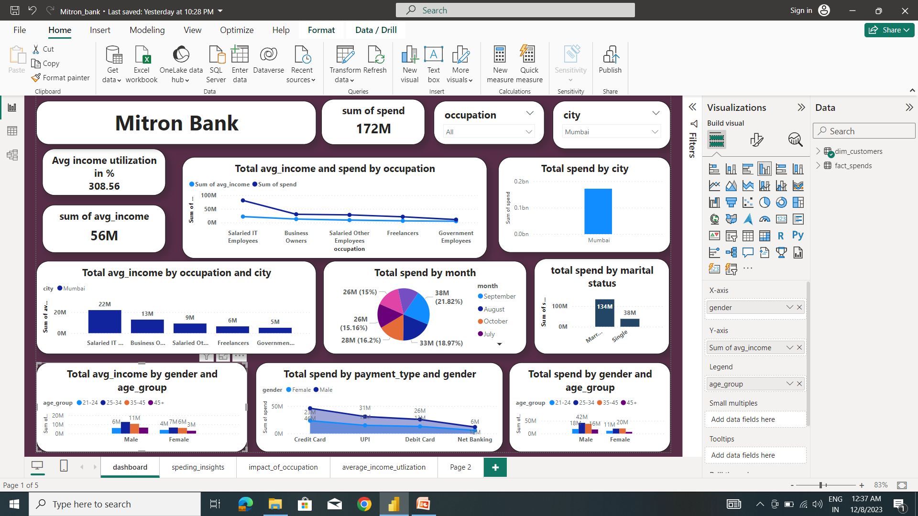
Mumbai city dashboard :

Slide 9
Total avg_income by occupation Mumbai city :
Occupation | Avg_income
Salaried IT employees | 22 Millions
Business Owners | 13 Millions
Salried other empoyees | 9 Millions
Freelancers | 6 Millions
Govermrnt employees | 5 Millions

Slide 10
Total avg_income by gender and age_group of Mumbai city :
Age_group | Gender | Avg_income
21-24 | Male | 6 Millions
25-34 | Male | 13 Millions
35-45 | Male | 11 Millions
45+ | Male | 7 Millions
21-24 | Female | 4 Millions
25-34 | Female | 7 Millions
35-45 | Female | 6 millions
45+ | Female | 3 Millions

Slide 11
Total spend by payment and gender of Mumbai city:
Payment | Gender | spend
Credit card | Male | 46 Millions
UPI | Male | 31Millions
Debit card | Male | 26 Millions
Net Banking | Male | 12Millions
Credit card | Female | 23 Millions
UPI | Female | 15 Millions
Debit card | Female | 13 millions
Net Banking | Female | 6 Millions

Slide 12
Total spend by age_group and gender of Mumbai city :
Age-group | Gender | spend
21-24 | Male | 18 Millions
25-34 | Male | 42 Millions
35-45 | Male | 38 Millions
45+ | Male | 16 Millions
21-24 | Female | 11 Millions
25-34 | Female | 19 Millions
35-45 | Female | 20 Millions
45+ | Female | 7 Millions

Slide 13
Insights from City Bengaluru
Average_income for the benagaluru city is 38 millions
Benagaluru city total spend is 100 milllions
Average income utilization is 260.76
Spending amount based on the month is:
Month | spend
May | 13 Millions
june | 15 Millions
july | 15 Millions
aug | 19 Millions
sep | 22 Millions
oct | 16 Millions

Slide 14
Total spend based on Marital status of Bengaluru city :
Marital status | spend
married | 81 Millions
Single | 19 Millions

Slide 15
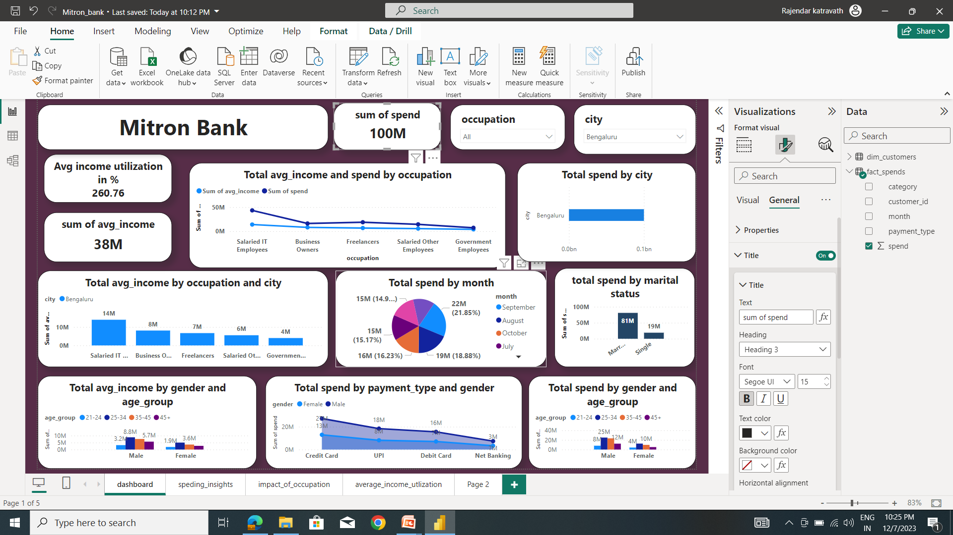
Dashboard of Bengaluru city:

Slide 16
Total Average income by gender and age-group of bengaluru city :
Age_group | gender | Avg_income
21-24 | male | 3.2 millions
25-34 | male | 8.8 millions
35-45 | male | 7.6 millions
45+ | male | 5.7 millions
21-24 | female | 1.9 millions
25-34 | female | 5.0 millions
35-45 | female | 3.6 millions
45+ | female | 2.7 millions
Age_group | gender | Avg_income
21-24 | male | 3.2 millions
25-34 | male | 8.8 millions
35-45 | male | 7.6 millions
45+ | male | 5.7 millions
21-24 | female | 1.9 millions
25-34 | female | 5.0 millions
35-45 | female | 3.6 millions
45+ | female | 2.7 millions

Slide 17
Total spend by payment type and gender of bengaluru city:
Payment type | gender | Spend amount
Credit card | male | 27 millions
UPI | male | 18 millions
Debit card | male | 16 millions
Net banking | male | 7 millions
Credit card | female | 13 millions
UPI | female | 8 millions
Debit card | female | 7 millions
Net banking | female | 3 millions

Slide 18
Total spend by age_group and gender of bengaluru city:
Age_group | gender | Spend amount
21-24 | female | 4 millions
25-34 | female | 12 millions
35-45 | female | 8 millions
45+ | female | 5 millions
21-24 | male | 8 millions
25-34 | male | 25 millions
35-45 | male | 23 millions
45+ | male | 12 millions

Slide 19
Insights from chennai city :
Average income of chennai is 43 millions
Total spend of chennai is 80 millions
Average income utilzation percentage is 186.6
Total income spend by the marital status of chennai city:
Marital status | spend
Married | 66 Millions
single | 14 Millions

Slide 20
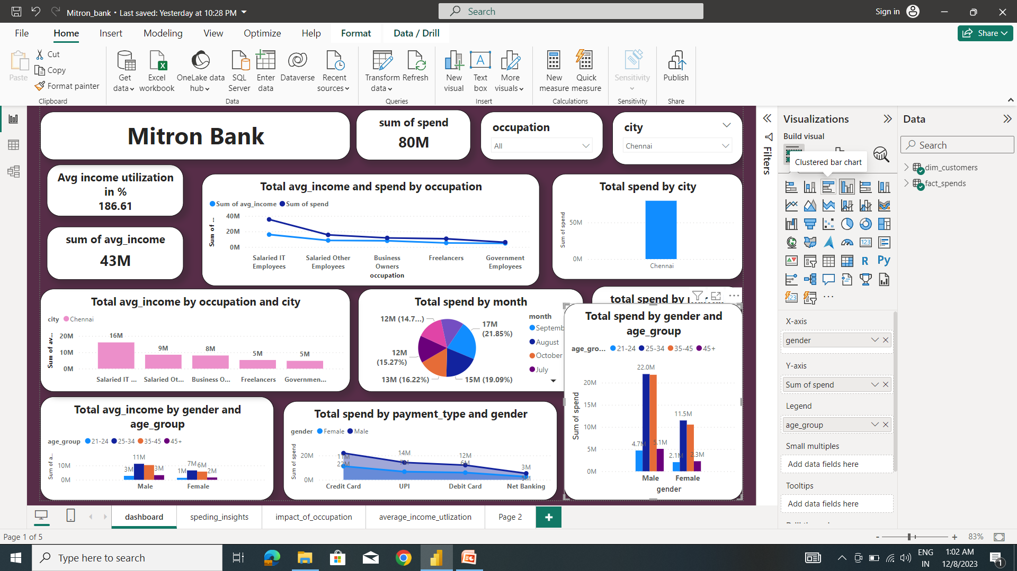
Chennai city dashboard :

Slide 21
Total spend by month of chennnai city:
Month | spend
May | 10 Millions
June | 12 Millions
July | 12 Millions
Aug | 15 Millions
sep | 17 Millions
Oct | 13 Millions

Slide 22
Total avg_income by occupation and of chennai city :
occupation | city | Avg_income
Salried IT employees | chennai | 16 Millions
Salried other employees | chennai | 9 Millions
Business owners | chennai | 8 Millions
Freelancers | chennai | 5 Millions
Government employeers | chennai | 5 Millions

Slide 23
Total avg_income by age_group and gender of chennai city :
Age_group | Gender | Avg_income
21-24 | Female | 1.4 Millions
25-34 | Female | 6.6 Millions
35-45 | Female | 5.7 Millions
45+ | Female | 1.6 Millions
21-24 | Male | 2.8 Millions
25-34 | Male | 11.2 Millions
35-45 | Male | 10.3 Millions
45+ | Male | 3.2Millions

Slide 24
Total Spend by payment_type and gender of chennai city :
Payment_type | Gender | Spend
Credit card | Female | 22 Millions
UPI | Female | 14 Millions
Debit card | Female | 12 Millions
Net Banking | Female | 5 Millions
Credit card | Male | 11 Millions
UPI | Male | 7 Millions
Debit card | Male | 6 Millions
Net Banking | Male | 3 Millions

Slide 25
Total Spend by age_group and genderin chennai city:
Age_group | Gender | Spend
21-24 | Female | 2.1Millions
25-34 | Female | 11.5Millions
35-45 | Female | 10.5Millions
45+ | Female | 2.3Millions
21-24 | Male | 4.7 Millions
25-34 | Male | 22Millions
35-45 | Male | 21Millions
45+ | Male | 5.1 Millions

Slide 26
Insights from the Delhi city
Average income of delhi city is 43 millions
Total spend of the delhi is 111 millions
Average income utiization percentage is is 288.17
Total spend my the marital status in delhi city :
Marital status | spend
Married | 91 Millions
single | 20 Millions

Slide 27
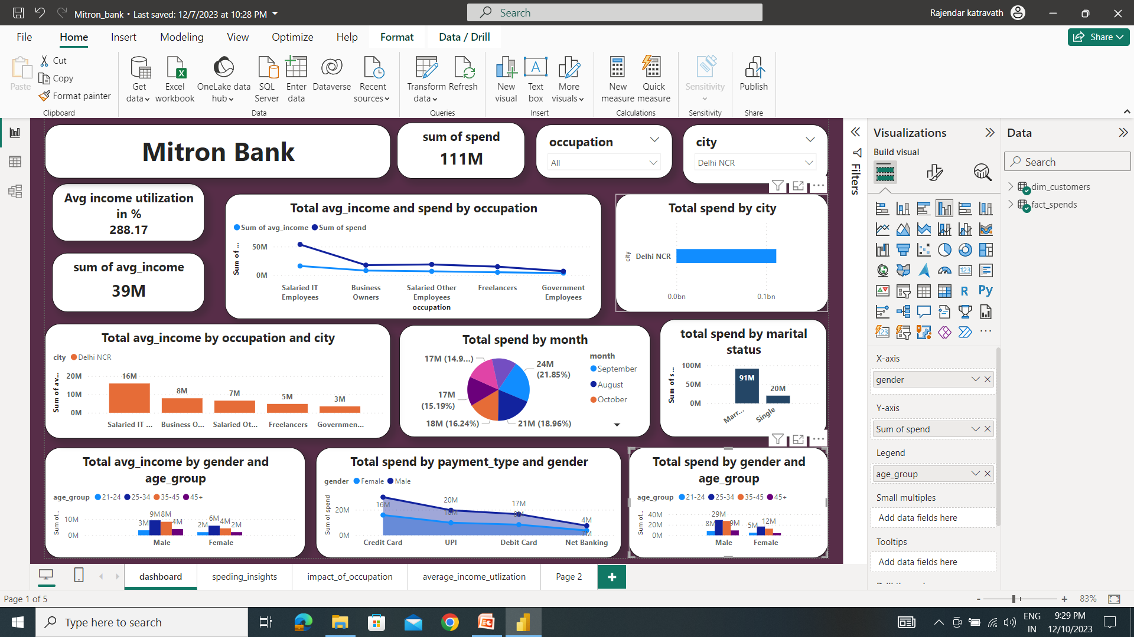
Delhi city dashboard :

Slide 28
Total spend by month in delhi city :
Month | spend
May | 14 Millions
June | 17 Millions
July | 17 Millions
Aug | 21 Millions
Sep | 24 Millions
Oct | 18 Millions

Slide 29
Total avg_income by occuaption of delhi city :
occupation | city | Avg_income
Salaried IT employees | Delhi | 16 mIllions
Business owners | Delhi | 8 millions
Salried other employeers | Delhi | 7 Millions
Freelancers | Delhi | 5 Millions
Government employees | Delhi | 3 Millions

Slide 30
Total avg_income by gender and age_group of delhi city :
Age_group | Gender | Avg_inomce
21-24 | Female | 1.9 Millions
25-34 | Female | 5.9 Millions
35-45 | Female | 4.3 Millions
45+ | Female | 1.9 Millions
21-24 | Male | 3.1 Millions
25-34 | Male | 9.3 Millions
35-45 | Male | 8.4 millions
45+ | Male | 3.8 Millions

Slide 31
Total spend by payment_type and gender of delhi city:
Payment_type | Gender | Avg_inomce
Credit card | Female | 30 Millions
UPI | Female | 20 Millions
Debit card | Female | 17 Millions
Net Banking | Female | 7 Millions
Credit card | Male | 16 Millions
UPI | Male | 10 Millions
Debit card | Male | 8 millions
Net Banking | Male | 4 Millions

Slide 32
Total spend by age_group and gender of delhi city:
Age_group | Gender | Spend
21-24 | Female | 4.7 Millions
25-34 | Female | 16.6 Millions
35-45 | Female | 12.5 Millions
45+ | Female | 4.0 Millions
21-24 | Male | 8.2 Millions
25-34 | Male | 29.0 Millions
35-45 | Male | 27.3 millions
45+ | Male | 9.1Millions

Slide 33
Insights from Hyderabad city
Total average income of Hyderabad city is 31 millions
Total spend by the Hyderabad city is 68 millions
Income utilization in percentage by the city is 217.52
Total spend my marital status of Hyderabad city :
Marital status | spend
Married | 57 Millions
single | 11 Millions

Slide 34
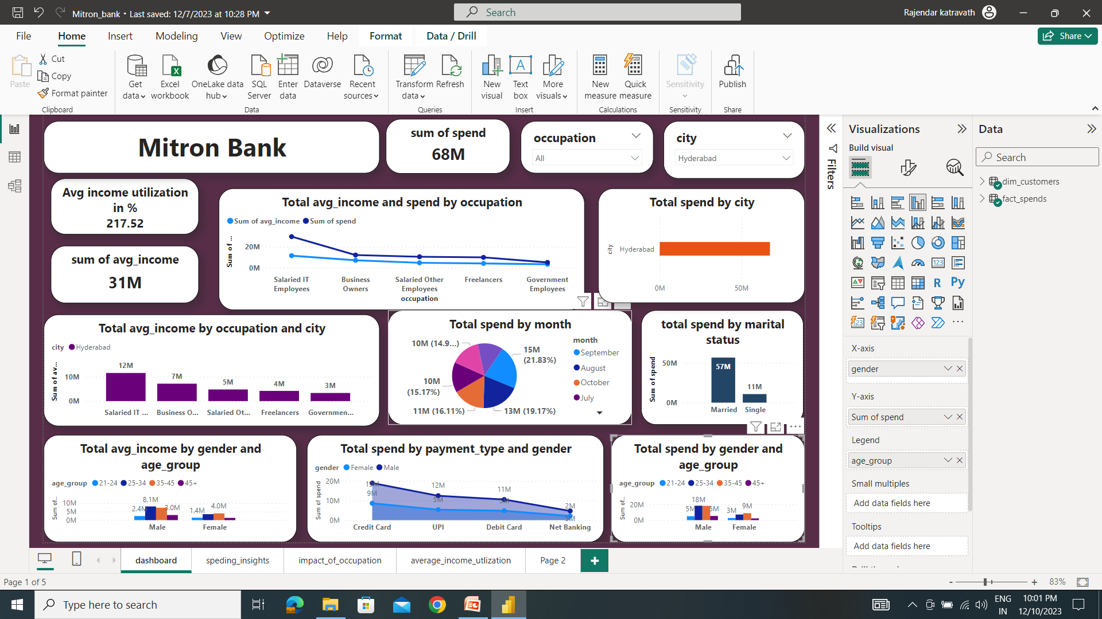
Hyderabad city Dashboard:

Slide 35
Total spend by Month of Hyderabad city:
Month | Spend
May | 9 Millions
June | 10 Millions
July | 10 Millions
Aug | 13 Millions
Sep | 15 Millions
Oct | 11 Millions

Slide 36
Total avg_income by occupation of Hyderabad city :
occupation | city | Avg_income
Salried IT employees | Hyderabad | 12 Millions
Busniess owners | Hyderabad | 7 Millions
Salaried other employees | Hyderabad | 5 Millions
Freelancers | Hyderabad | 4 Millions
Government employees | Hyderabad | 3 Millions

Slide 37
Total avg_income by gender and age_group of Hyderabad city :
Age_group | Gender | Avg_income
21-24 | Female | 1.4 Millions
25-34 | Female | 3.5 Millions
35-45 | Female | 4.0 Millions
45+ | Female | 1.3 Millions
21-24 | Male | 2.4 Millions
25-34 | Male | 8.1 Millions
35-45 | Male | 7.3 Millions
45+ | Male | 3.0 Millions

Slide 38
Total spend by payment type and gender of Hyderabad city :
Payment _type | Gender | Spend
Credit card | Female | 8.6 Millions
UPI | Female | 5.4 Millions
Debit card | Female | 4.8 Millions
Net Banking | Female | 2.1 Millions
Credit card | Male | 18.9 Millions
UPI | Male | 12.5 Millions
Debit card | Male | 10.5 Millions
Net Banking | Male | 4.7 Millions

Slide 39
Total spend by gender and age_group of Hyderabad city :
Age_group | Gender | spend
21-24 | Female | 2.7 Millions
25-34 | Female | 7.1 Millions
35-45 | Female | 8.8 Millions
45+ | Female | 2.2 Millions
21-24 | Male | 5.0 Millions
25-34 | Male | 18.3 Millions
35-45 | Male | 18.0Millions
45+ | Male | 5.3 Millions

Slide 40
Conclusion:
In every cities there is a high chance to use the credit card .because the income utilization is high .
Mostly customers spending amount through the credit cards .
Total avg_income in every cities of age group is like 25-34, 35-45 is high .especially males have high average income.
Marital status of married category is spending the high income.
In occupation IT employees are getting the highest avg_income and they only spending highest income when compared to other occupations .

Slide 41
Credit card feature recommendations :
Some credit card features recommendations backed by data insights and informed by industry trends:
customizable spending limits
Tailored rewards program
contactless payment options
Real-time transcations notifications
Comprehensive travel benefits
Low-intrest rate introductory period
Finanical management tools
Exclusive merchant discounts
Credit score monitoring
Special pomotions and limited –time offers

Slide 42
12. Digital wallet integration
143. Customer support enhancement
THANK YOU..!

